Slide 1
Linux
Base commands

Slide 2
Overview
The Linux command line is a text interface to your computer.
Usually called terminal or cmd prompt in windows
The terminal is a windows to the shell
Command is simple statement with key words and following a syntax
Cd doc2
Command line syntax : command name - option inputs

Slide 3
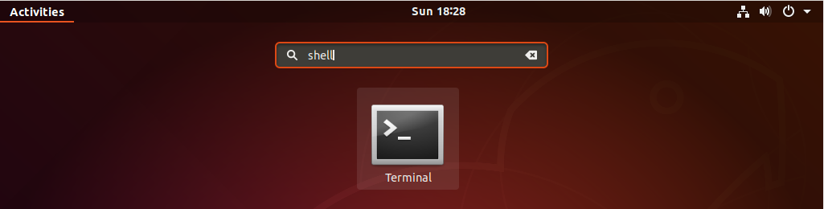
Opening a terminal
you can find a launcher for the terminal by typing the first few letters of “terminal”, “command”, “prompt” or “shell” in the search field .

Slide 4
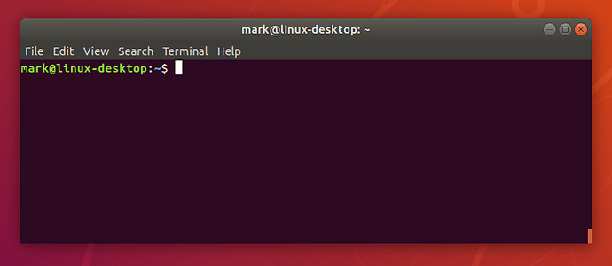
Terminal overview

Slide 5

Why command line
We execute the command to interact with the machine as we do now
Before there is no interface
by the end we hope you’ll feel a bit more comfortable the next time you’re faced with some instructions that begin “Open a terminal”.
And now we can start executing our commands

Slide 6
Pwd command
the pwd command (print working directory) writes the full pathname of the current working directory to the standard output.
equivalent MS-DOS/MS Windows : chdir
Syntax : pwd
Echo command
echo command in linux is used to display line of text/string that are passed as an argument

Slide 7
Ls command
Ls command is used to list the content of the folder when you run it
Think of it as double-clicking on a folder in Windows
Equivalent MS-DOS/MS Windows : dir
Syntax ls
Options
Ls- a list the content with the cache files
ls - l list the content with permissons model
Ls –R list the folders and the sub-folders with all the files (in details ) .

Slide 8
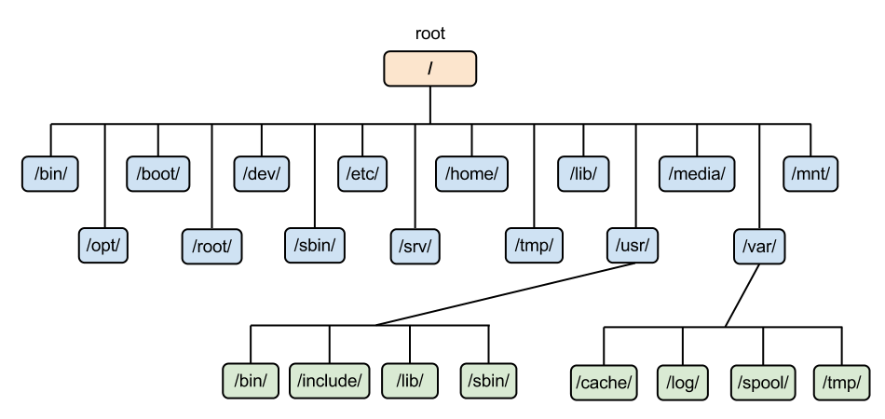
Cd command
Cd known as change directory command. It is used to change current working directory.
equivalent MS-DOS/MS Windows : cd
Syntax: cd [directory]
Options
Cd .. Return to the previous folder
Cd / return the the root folder

Slide 9
Cp command
cp stands for copy. This command is used to copy files or group of files or directory. It creates an exact image of a file on a disk with different file name.
equivalent MS-DOS/MS Windows : copy
Syntax Cp file name new file name
Options
Cp file name rep/
Cp –r folder name/ folder destination/ to copy a folder

Slide 10
Mv command
The ‘mv’ (move) command can be used for renaming directorieso r files . Use the below-given format.
Syntax: mv file name new file name

Slide 11
Rm command
Use this command to delete one or more files or directories. Include one or more instances of the <FILE> variable, separating each with a whitespace, and set it to the complete path to be deleted.
equivalent MS-DOS/MS Windows : del
Syntax rm file name
Options
Rm – i (ask for confirmation before delete )
Rm –rf folder name / (delete the folder and the sub folders )

Slide 12
Mkdir command
Use this command to create one or more new directories. Include one or more instances of the “ <DIRECTORY ” variable (separating each with a whitespace), and set each to the complete path to the new directory to be created. If directories within a named path do not exist, an error will be generated.
equivalent MS-DOS/MS Windows : mkdir
Syntax : mkdir folder name
Options
mkadir –p folder1/folder2/folder3/

Slide 13
Cat command
The cat command is a utility command in Linux. One of its most commonly known usages is to print the content of a file onto the standard output stream. Other than that, the cat command also allows us to write some texts into a file
Syntax : Cat > file name
When you finish typing
press ctrl + d
Options
tail file name : to read the 10 last lines
Head file name: to read 10 first lines

Slide 14
Rmdir command
The rmdir command removes the directory, specified by the Directory parameter, from the system. The directory must be empty before you can remove it, and you must have write permission in its parent directory.
equivalent MS-DOS/MS Windows : del
Syntax : rmdir folder name
Options
Rmdir –p foldername/ folder name2 /

Slide 15
Chmod command
file
File owner
Users
Group
read
read
execute
read
write
write
execute
execute
write

Slide 16
Chmod command
To change mode of a file system object.
Files can have r – read, w- write and x-execute permissions.
For example:
Syntax chmod mode FILE
chmod 744 script.sh
The first number stands for the user who is associated with the file
The second number is for the group associated with the file
The third number is associated with everyone else who is not a part of the user or group
we represent the user with (u), the group (g), the others(o)

Slide 17
Chmod command
Octal Notation Permission Symbolic Representation
1 Execute Permission Only --x
2 Write Permission Only -w-
3 Write and Execute Permissions (1+2)=3 -wx
4 Read Permission Only r--
5 Read and Execute Permissions (1+4)=5 r-x
6 Read and Write Permissions (2+4)=6 rw-
7 Read, Write and Execute Permissions, Means Full Permissions (1+2+4)=7 rwx

Slide 18
Other commands
Uname brings information of the system
Sudo passwd used to change the password
History brings you all the command you have used before
Date brings you the date
Clear clear everything in the terminal
Man used as manual to any command
Sudo

Slide 19


